Slide 1

Fraud Detection on Credit Card Transaction
Presented By :Denish Lamichhane
Sanjeep Banjara

Slide 2
Agenda
1
2
3
4
5
Introduction
How frauds are recognized?
Objectives
Data Collection
Flow Chart

Slide 3
Agenda
6
7
8
9
10
Exploratory Data Analysis (EDA)
Logistic Regression
Results
Future Work
Conclusion

Slide 4
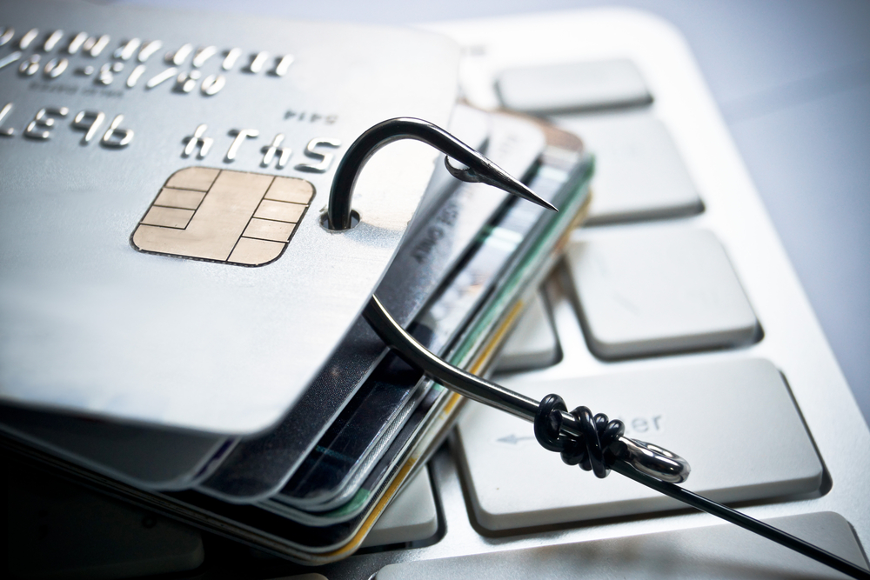
Introduction
Credit card fraud is when someone uses your credit card or credit account to make a purchase you didn’t authorize.
Credit card fraud poses significant risks to individuals, businesses, and financial institutions, necessitating robust security measures and proactive detection mechanisms to safeguard against unauthorized and fraudulent activities.

Slide 5
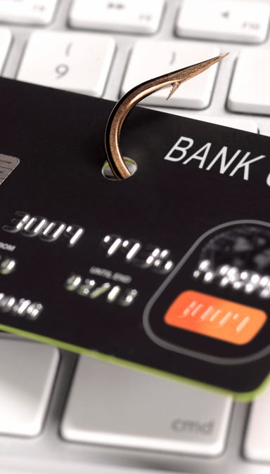
How frauds are recognized?
Location :- Purchase made from different location
Items you buy :- If you deviate from items your regular buying pattern or time
Frequency :- Make a larger number of transactions in short period of time
Amount :- Suddenly if the costly items are purchased

Slide 6
Objectives
Detect maximum fraud transactions
Enhance Security in Financial Transactions
Contribute to Industry Best Practices

Slide 7
Data Collection
Sourced from Kaggle
Consisting 32 variables & 284806 transactions with 0.17% fraud cases
Highly unbalanced and skewed towards fraud class

Slide 8
Flow Chart
Dataset
Data preprocessing
Applying algortihms
Prediction

Slide 9
Exploratory Data Analysis (EDA)
Descriptive Statistics
Data Distribution Analysis
Correlation Analysis
Fraud vs. Non-Fraud Comparisons
Distribution of Transaction Time
Visualization

Slide 10
Logistic Regression
Logistic Regression is well-suited for problems where the outcome is binary, such as yes/no or fraud/non-fraud.
It models the relationship between the independent variables and the log-odds of the dependent variable, assuming a linear relationship.
Utilizes the sigmoid (logistic) function to squash the linear output into a range between 0 and 1, representing probabilities.
Despite its simplicity, Logistic Regression is widely used in various fields due to its effectiveness, ease of implementation, and interpretability.

Slide 11
Results
Final Precision: 0.8161
Final Recall: 0.5772
Final F1-Score: 0.6762

Slide 12





Future Work
Algorithm Enhancement
Feature Engineering Refinement
Real-time Monitoring
Collaboration with Industry Experts
Integration with Fraud Prevention Systems

Slide 13

Conclusion
In summary, our journey into credit card fraud detection using Logistic Regression sets the stage for a secure financial future. As we progress, refining our model and embracing advanced techniques, our commitment to evolving fraud detection remains unwavering. Together, we pave the way for a safer and more resilient financial ecosystem.

Slide 14


Meet our team
Denish Lamichhane
denishlamichhane1@gmail.com
Sanjeep Banjara
sanjeepbanjara@gmail.com

Slide 15

Thank you

